Slide 1
Possible Hardware Architectures for MagSense v2

Slide 2
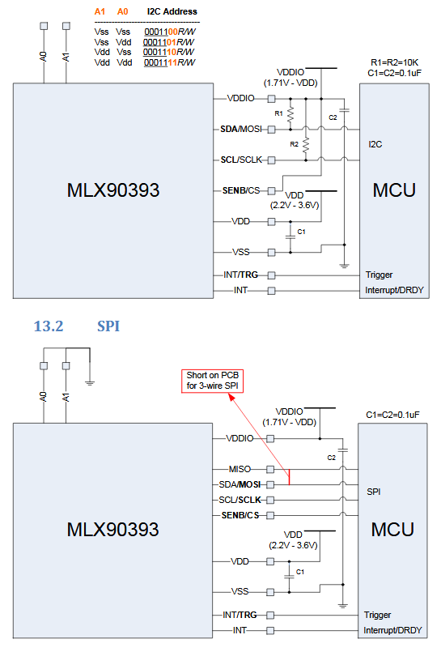
Device
Two interface protocols
i2c transfer up to 400 kHz
Not achieving this currently, possible clock stretching?
SPI transfer up to 10 MHz
Protocols very similar but SPI untested
Running in burst mode
Should return last measurement obtained when read
Has interrupt pin to indicate measurement ready

Slide 3
Requirements
~100 nodes @ ~100 Hz
Frontend easy to modify for changing TX protocol and SD card writing
Simple PCB design for flex implementation
Commonality between this design and hall effect version desirable

Slide 4
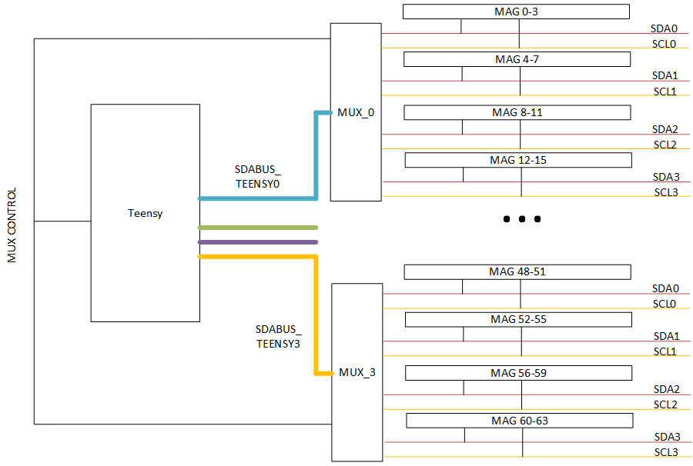
Current architecture
Each mux provides 4 i2c lines
4 nodes per mux line
Common mux-select that connects 4 nodes to each teensy i2c bus at a time
Asynchronous reading across each teensy bus gives 127 Hz
Easy pickup in future, quick development
Not scalable with same frame rate
Messy, hard board design for 100+ nodes

Slide 5
‘Smart mux’ architecture
KL02 is tiny (2mm*2mm) AVR-based micro
Each provides two local buses – 8 nodes
Handles all data collection and then passes to teensy with SPI/i2c
Run identical code, works position out from ADC value.
High IC Count
Large fan out from very small device
Simple, quick design

Slide 6
SPI version
Same but with SPI instead
Very high fanout
Less ICs

Slide 7
Passive FPGA Option
Use FPGA to expand number of I/O busses available to uC
Teensy programmer has no awareness of FPGA
Long time to develop robust protocol that includes everything
Provides most control to software
As many i2c busses as FPGA pins
Code reusable

Slide 8
FPGA with SDRAM Interface
Parallel interface between teensy and FPGA (fast)
FPGA handles all low level comms and makes memory available on output
Reading in AVR (including Arduino) simple as reading from array. Silicon handles everything.
Simple FPGA design
Simple software design
No control over low level comms without changing FPGA design

Slide 9
System on Chip
Run ARM uC on FPGA
Add busses as required
ARM uC sees busses transparently
Everything coded in C
Might need lots of support electronics
Expensive, licensing etc

